Slide 1

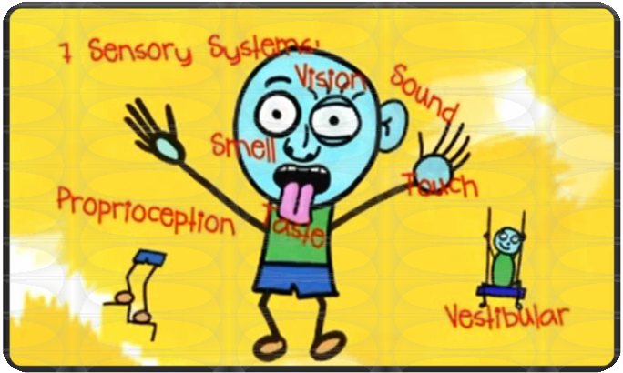

Sensory Processing
The Rise School
14th June 2019

Slide 2
What does sensory overload feel like?
https://www.youtube.com/watc
h?v=zU45hUuMNUM

Slide 3
Sensory Processing
The ability to register, discriminate, adapt and respond appropriately, both physically and emotionally to sensory input from the environment.

Slide 4

We ALL process sensory
information in different ways...
✓Studying with the TV on?
✓Sleeping with no light on?
✓Fiddling with hair?
✓Rocking chair back?
✓Chewing on pen when concentrating?
✓Feeling calmer after exercising?
✓Find a massage relaxing?

Slide 5

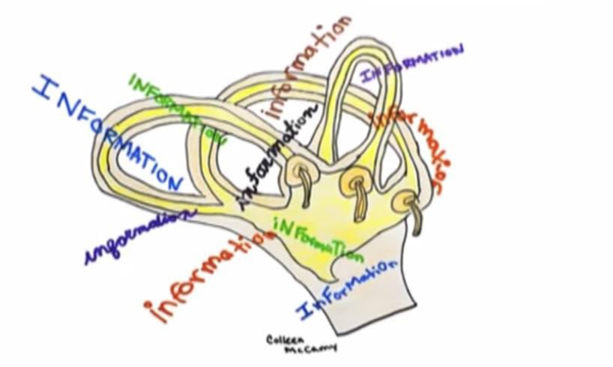


Proprioceptive system
Vestibular system

Slide 6
A Child's View of Sensory
Processing
http://www.youtube.com/watch?v=D1G5ssZlVUw&sa fe=active

Slide 7
Passive
Hard to motivate
Looks ‘fine’ with anything
Needs a lot of prompting to initiate and maintain engagement
•Might avoid messy play or Noisy rooms
•Might complain, scream or protest when being touched
•Might get more anxious when he is out on the playground or in a busy room
Low registration
Sensory defensive
Too low
Too high
Sensory seeking
Sensory avoider
Appears relatively passive
Moves away from situations, especially when ‘too much is going on’
Avoids anything new and has very ‘clear views’ on what and how he wants something
Constantly moving
Fidgety
Putting things in mouth
Never seems to get enough

Slide 8




Slide 9
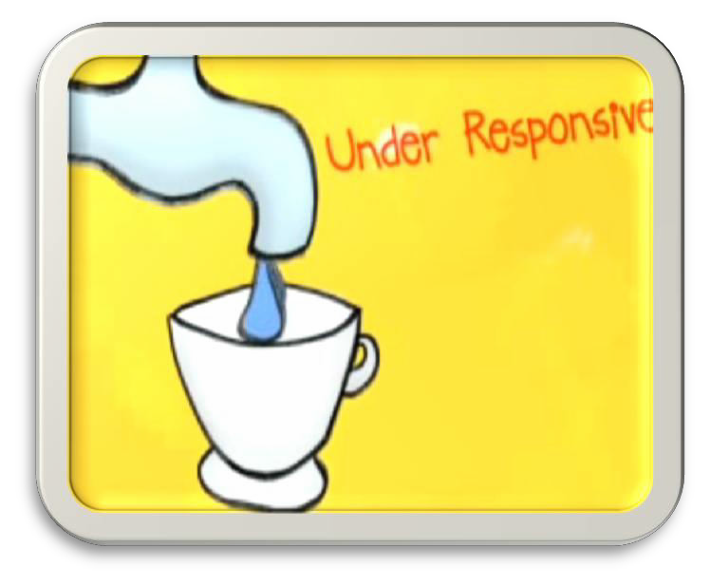


1. Low Registration
•Passive, un-interested
with low energy levels.
•Slow to respond.
•Appears to be ‘lazy’.
The brain is not receiving adequate levels of sensory information to enable the child to respond.

Slide 10
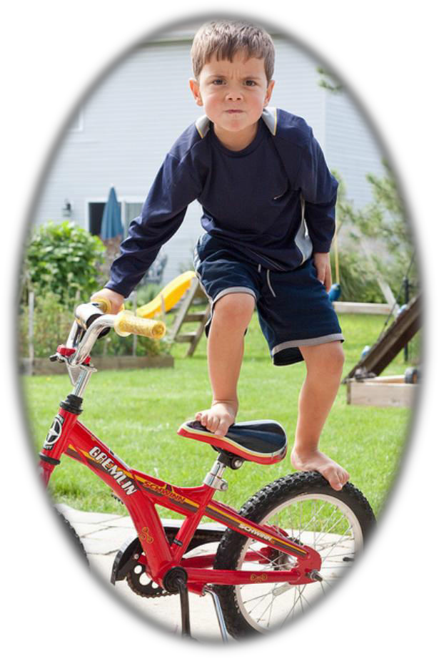



http://www
g
107609

Slide 11
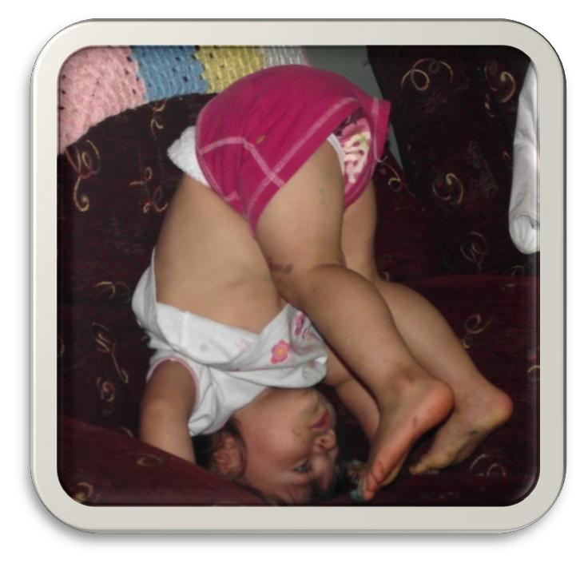
2. SENSORY SEEKING
•Active, ‘on the go’ appears excitable and unaware of their own safety.
•Has trouble tolerating
low stimulus environments –
easily ‘bored’.
•Will be adding sensory input to their day, - making
noises, fidgeting, chewing, touching, climbing.

Slide 12
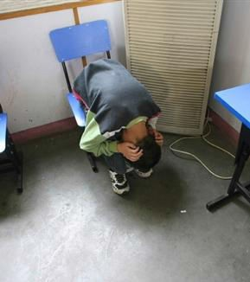






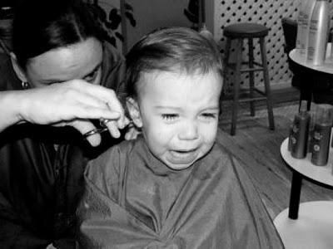



Slide 13
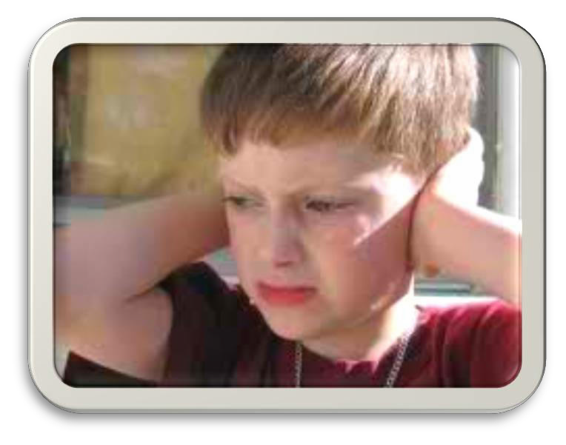
3. SENSORY SENSITIVE
•Vigilant -notices things other people don’t notice
•Easily distracted,
hyper-active.
•Complainer
•Highly aware of their
surroundings, difficulty filtering out unwanted
sensory information.

Slide 14

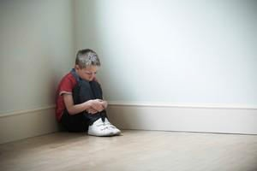


Slide 15
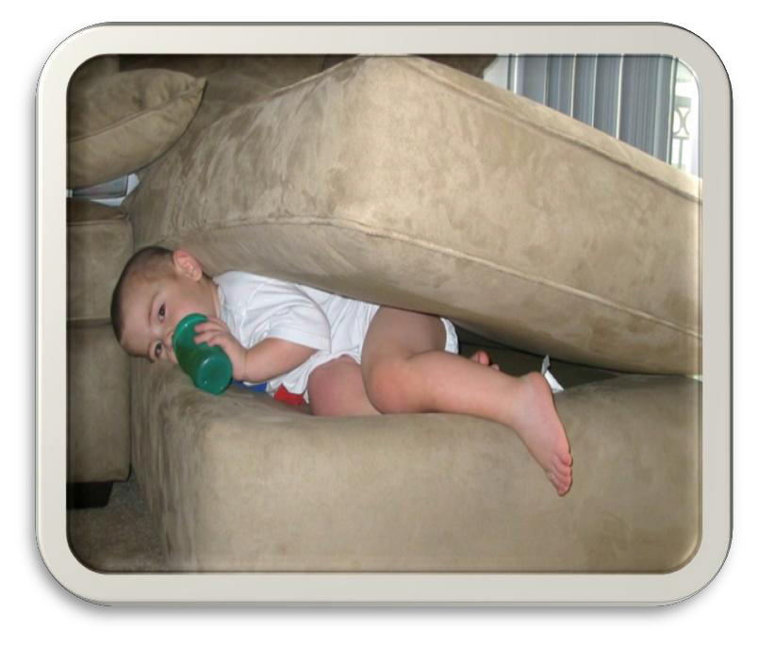
4. SENSORY AVOIDING
•Appears withdrawn, emotional, stubborn and controlling.
•Intentional withdrawal
from stimuli.
•May appear manipulative.
•May create rituals to reduce fear in an
attempt to feel safe.

Slide 16
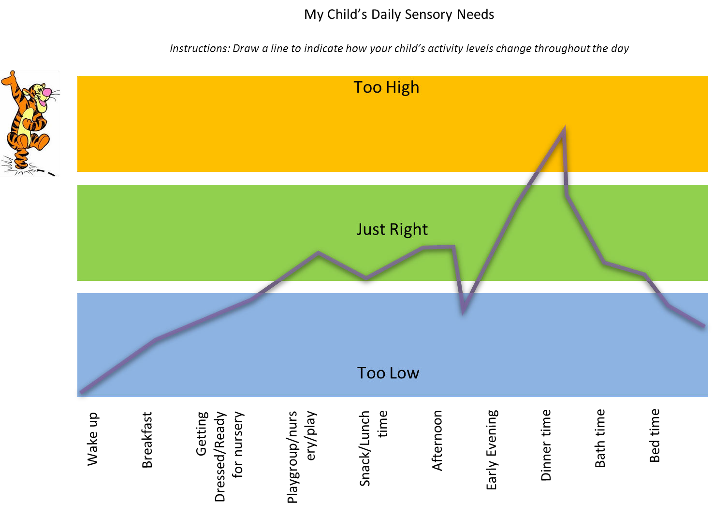
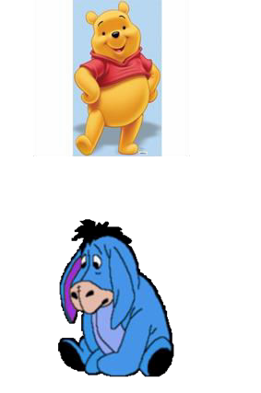
33

Slide 17






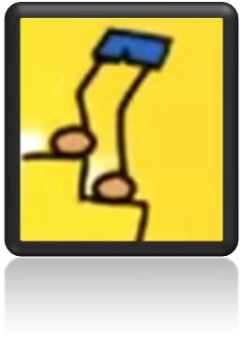
Sensory strategies

Slide 18
The Sensory Room:
Helping Students With Autism Focus & Learn
https://www.youtube.com/watch?v=T9j6rQ4rtQY

Slide 19



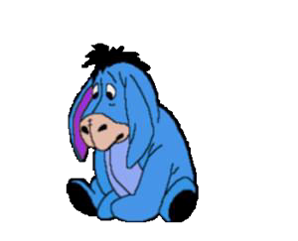


Sensory Strategies
If we’re too high - we want to calm down
=
If we’re too low - we want to be more alert
=

Slide 20
Support families to develop solutions
Optimise sensory properties of shared environments
Adapt tasks or environment
Support child to develop own self- regulation strategies
Sensory input within daily routines to modulate arousal
Behavioural Strategies

Slide 21
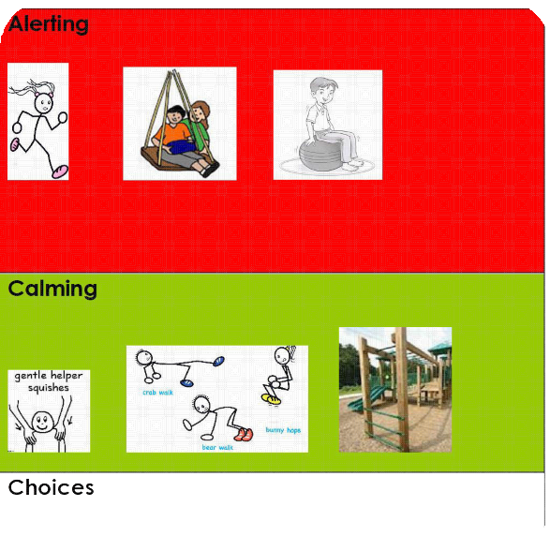


Sensory input within daily routines to modulate arousal
✓Calming
✓Alerting
✓Organising

Slide 22
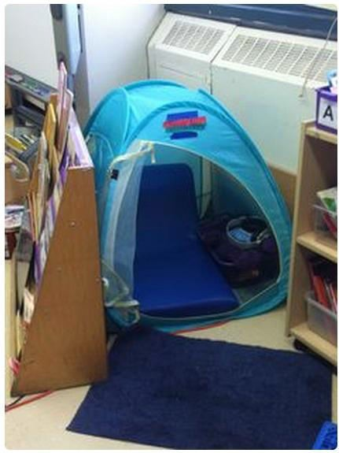

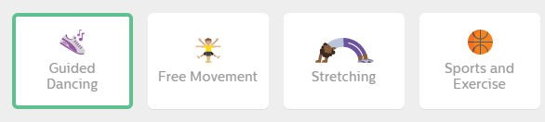

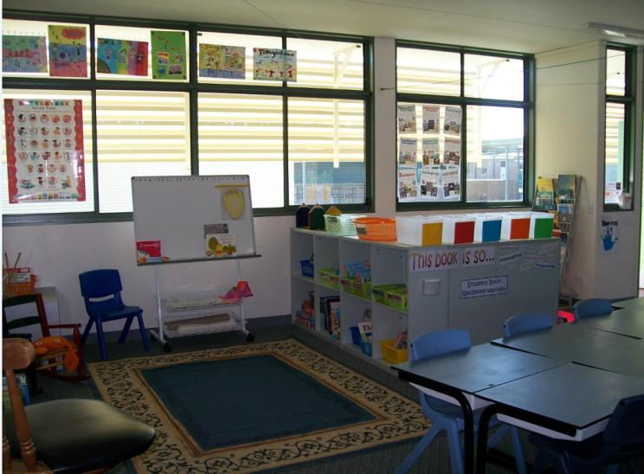
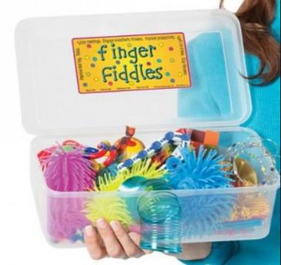
Whole Class Strategies

Slide 23
Final consideration…
Is it Sensory or Behaviour?

Slide 24




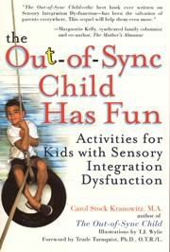
Useful books

Slide 25
Useful Websites
http://sensoryintegration.org.uk
http://www.spdfoundation.net
http://www.starcenter.us/
http://sensorystreet.com
http://sensoryworld.com
http://www.spdbloggernetwork.com

